Slide 1
Java Basics

Slide 2
Java Basics
Java is a programming language and a platform.
Java is a high level, robust, secured and object-oriented programming language.
Platform: Any hardware or software environment in which a program runs, is known as a platform. Since Java has its own runtime environment (JRE) and API, it is called platform.

Slide 3
History of Java
James Gosling and Sun Microsystems.
why Oak ?
Oak is a symbol of strength and chosen as a national tree of many countries like U.S.A., France, Germany, Romania etc.
Java, May 20, 1995, Sun World - Java is an island of Indonesia where first coffee was produced (called java coffee).
Notes:
Gherkin’s grammar is defined in the Treetop grammar that is part of the Cucumber codebase. The grammar exists in different flavours for many spoken languages (60 at the time of writing), so that your team can use the keywords in your own language.

Slide 4
Features

Slide 5
Feature cont…
Simple - Java is very easy to learn and its syntax is simple, clean and easy to understand. According to Sun, Java language is simple.
Object-oriented - Java is Object-oriented programming language. Everything in Java is an object. Object-oriented means we organize our software as a combination of different types of objects that incorporates both data and behaviour. simplifies software development and maintenance by providing some rules
Platform Independent - Java is platform independent because it is different from other languages like C, C++ etc. which are compiled into platform specific machines while Java is a write once, run anywhere language.
Secured –
No explicit pointer
Java Programs run inside virtual machine sandbox
Classloader: Classloader in Java is a part of the Java Runtime Environment(JRE) which is used to dynamically load Java classes into the Java Virtual Machine. It adds security by separating the package for the classes of the local file system from those that are imported from network sources.
Bytecode Verifier: It checks the code fragments for illegal code that can violate access right to objects.
Security Manager: It determines what resources a class can access such as reading and writing to the local disk.

Slide 6
Feature Cont…
Robust
It uses strong memory management.
There are lack of pointers that avoids security problem.
There is automatic garbage collection in java.
Architecture-neutral
Java is architecture neutral because there is no implementation dependent features e.g. size of primitive types is fixed.
Ex:- 4 bytes for int type.
Portable
Java is portable because it facilitates you to carry the java byte-code to any platform.
High-performance
Java is faster than traditional interpretation since byte-code is "close" to native code still somewhat slower than a compiled language.
Distributed
Java is distributed because it facilitates us to create distributed applications in java. Ex:- EJB (Enterprise Java Bean ) and RMI (Remote Interface).
Multi-threaded
A thread is like a separate program, executing concurrently. We can write Java programs that deal with many tasks at once by defining multiple threads.

Slide 7
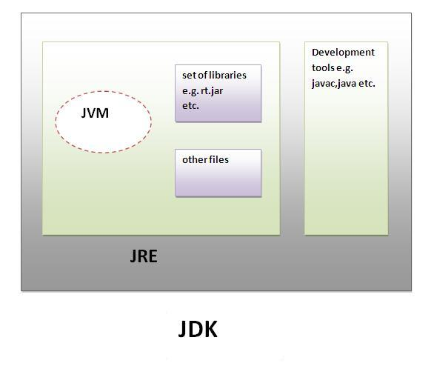
Difference between JDK, JRE and JVM
JVM
JVM (Java Virtual Machine) is an abstract machine. It is a specification that provides runtime environment in which java byte-code can be executed.
The JVM performs following main tasks:
Loads code
Verifies code
Executes code
Provides runtime environment
JRE
JRE is an acronym for Java Runtime Environment. It is used to provide runtime environment. It is the implementation of JVM. It physically exists. It contains set of libraries + other files that JVM uses at runtime.
JDK
JDK is an acronym for Java Development Kit. It physically exists. It contains JRE + development tools.
Notes:
Does coding knowledge required?

Slide 8
Path Vs Class Path
In PATH Environment variable you need to specify only .bat, .exe (Executable files that Operating System Uses).
In CLASSPATH environment you need to specify only .class files (i.e., jar, zip files – Inside jar, zip files you will find only java classes) i.e. you are helping Java Virtual Machine (JVM) to find Java class files
For running java application you need to set PATH alone.

Slide 9
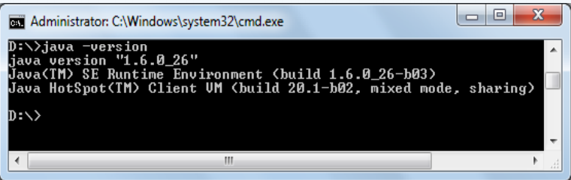
Path
Right click My Computer and click properties.
You will get System Properties window.
In that click Advanced->Environment variables.
In User variables for “yoursystemname”. Click New
In Variable name and in Variable value type as follows.
Variable name: JAVA_HOME
Variable value: D:\Java Variable name: PATH Variable value: %PATH%;%JAVA_HOME%\bin
Verify JDK: Use the java -version command, as shown below, to verify the installed release:

Slide 10
Why Path?
These .exe files can be accessed only from C:\Program Files\Java\jdk1.6.0_11\bin folder. Even you can run java programs without setting path. The thing is you need to type you program inside C:\Program Files\Java\jdk1.6.0_11\bin folder. Because java.exe, javac.exe…. are available only inside this folder.
We need to set path because we need to access java.exe, javac.exe…..(all the files which are required to run java program) any where in your computer i.e., c colon, d colon, e colon… . If we set PATH then all the .exe which is inside C:\Program Files\Java\jdk1.6.0_11\bin folder is available throughout all drives. So you can have java programs any where in your computer.

Slide 11
Variable
A Java variable is a piece of memory that can contain a data value. A variable thus has a data type.
Variable names are case-sensitive.
A variable's name can be any legal identifier — an unlimited-length sequence of Unicode letters and digits, beginning with a letter, the dollar sign "$", or the underscore character "_".
If the name you choose consists of only one word, spell that word in all lowercase letters. If it consists of more than one word, capitalize the first letter of each subsequent word.

Slide 12
Variable Types
There are three types of variables in java:
local variable
instance variable
static variable
1) Local Variable
A variable declared inside the method is called local variable.
void method(){
int n=90; //local variable
}
2) Instance Variable
A variable declared inside the class but outside the method, is called instance variable . It is not declared as static.
class Sample {
int data=50; //instance variable
}
3) Static variable
A variable which is declared as static is called static variable. It cannot be local.
static int m=100;//static variable

Slide 13
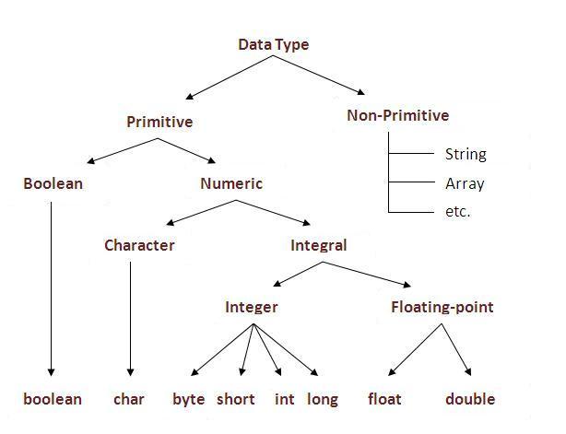
Data Types
Data types represent the different values to be stored in the variable. In java, there are two types of data types:
- Primitive data types
- Non-primitive data types

Slide 14
Primitive Data types
byte: The byte data type is an 8-bit integer.
short: The short data type is a 16-bit integer.
int: The int data type is a 32-bit integer.
long: The long data type is a 64-bit integer.
float: The float data type is a 32-bit floating point.
double: The double data type is a double-precision 64-bit floating point.
boolean: The boolean data type has only two possible values: true and false
char: The char data type is a single 16-bit Unicode character

Slide 15
Methods in JAVA
A Java method is a collection of statements that are grouped together to perform an operation.
Example:
public static int methodName(int a, int b)
{
// body
}
Here,
public static − modifier
int − return type
methodName − name of the method
a, b − formal parameters
int a, int b − list of parameters

Slide 16
Code structure in JAVA
class <ClassName> {
<Instance Variable Declaration(s)>…;
<Method Definitions>{
<Local Variable Declaration(s)>
Exception block{
Statements;
……
} <end of exception block>
};
}

Slide 17
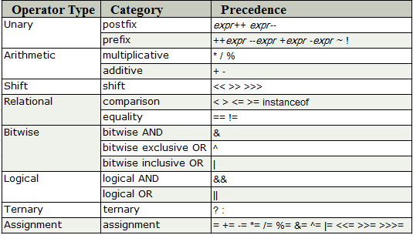
Operators in Java

Slide 18
Operators Example
Java Unary Operator
The Java unary operators require only one operand. Unary operators are used to perform various operations i.e.:
- incrementing/decrementing a value by one
- negating an expression
inverting the value of a Boolean
Example
class OperatorExample{
public static void main(String args[]){
int x=10;
System.out.println(x++);//10 (11)
System.out.println(++x);//12
System.out.println(x--);//12 (11)
System.out.println(--x);//10
}}

Slide 19
Operators Example
Arithmetic Operator
Java arithmatic operators are used to perform addition, subtraction, multiplication, and division. They act as basic mathematical operations.
// Example
class Operator{
public static void main(String args[]){
int a=10;
int b=5;
System.out.println(a+b);//15
System.out.println(a-b);//5
System.out.println(a*b);//50
System.out.println(a/b);//2
System.out.println(a%b);//0
}}

Slide 20
Operators Example
Unary Operator
// Example
class OperatorExample{
public static void main(String args[]){
boolean c=true;
boolean d=false;
System.out.println(!c);//false (opposite of boolean value)
System.out.println(!d);//true
}}
Logical && and Bitwise &
The logical && operator doesn't check second condition if first condition is false. It checks second condition only if first one is true.
//Example
class OperatorExample{
public static void main(String args[]){
int a=10;
int b=5;
int c=20;
System.out.println(a<b&&a<c);//false && true = false
System.out.println(a<b&a<c);//false & true = false }}

Slide 21
Operators Example
Logical && and Bitwise &
//Example
class OperatorExample{
public static void main(String args[]){
int a=10;
int b=5;
int c=20;
System.out.println(a<b&&a++<c); //false && true = false
System.out.println(a); //10 because second condition is not checked
System.out.println(a<b&a++<c); //false && true = false
System.out.println(a); //11 because second condition is checked
}}
Output:
false
10
false
11

Slide 22
Operators Example
Java Ternary Operator
Java Ternary operator (?:) is used as one liner replacement for if-then-else statement and used a lot in java programming. it is the only conditional operator which takes three operands.
// Example
class OperatorExample{
public static void main(String args[]){
int a=2;
int b=5;
int min=(a<b)?a:b;
System.out.println(min);
}}
output: 2

Slide 23
Operators Example
Java Assignment Operator
Java assignment operator is one of the most common operator. It is used to assign the value on its right to the operand on its left.
Example:
class OperatorExample{
public static void main(String args[]){
int a=10;
int b=20;
a+=4;//a=a+4 (a=10+4)
b-=4;//b=b-4 (b=20-4)
System.out.println(a);
System.out.println(b);
}}
output:
14
16

Slide 24
Java Control Statement
Java If-else Statement
if statement
if(condition){
//code to be executed
}
if-else statement
if(condition){
//code if condition is true
}else{
//code if condition is false
}
if-else-if ladder
if(condition1){
//code to be executed if condition1 is true
}else if(condition2){
//code to be executed if condition2 is true
}
else{
//code to be executed if all the conditions are false
}
Nested if

Slide 25
Java Switch Statement
The Java switch statement executes one statement from multiple conditions. It is like if-else-if ladder statement.
public class Switch {
public static void main(String[] args) {
int number=20;
switch(number){
case 10: System.out.println("10");break;
case 20: System.out.println("20");break;
case 30: System.out.println("30");break;
default: System.out.println("Not in 10, 20 or 30");
}
}
}

Slide 26
Loops in Java
In programming languages, loops are used to execute a set of instructions/functions repeatedly when some conditions become true. There are three types of loops in java.
for loop
while loop
do-while loop
For Loop: used to iterate a part of the program several times. If the number of iteration is fixed, it is recommended to use for loop.
for(int i=1;i<=10;i++){
System.out.println(i);
}
While Loop: If the number of iteration is not fixed, it is recommended to use while loop.
int i=1;
while(i<=10){
System.out.println(i);
i++; // i=+1;
}

Slide 27
Loops in Java
Do While: do-while loop is executed at least once because condition is checked after loop body.
Example:
int i=1;
do{
System.out.println(i);
i++;
}while(i<=10);
}
}
o/p: 1,2,…….10
Break: The Java break is used to break loop or switch statement.
public class BreakExample {
public static void main(String[] args) {
for(int i=1;i<=10;i++){
if(i==5){
break;
}
System.out.println(i);
} } }
O/P: 1,2,3,4

Slide 28
Java Comments
Continue Statement:
The continue statement is used in loop control structure when you need to immediately jump to the next iteration of the loop. It can be used with for loop or while loop.
Example:
public class ContinueExample {
public static void main(String[] args) {
for(int i=1;i<=10;i++){
if(i==5){
continue;
}
System.out.println(i); } } }
Output: 1,2,3,4,6,7,8,9,10
There are 3 types of comments in java.
Single Line Comment -- //This is single line comment
Multi Line Comment -- /* -----Multiple lines comment-----------------*/

Slide 29
Simple Program Assignment
1. Print the numbers until integer 10.
2. Even or Odd number
3. Fibonacci series
4. Prime numbers

Slide 30
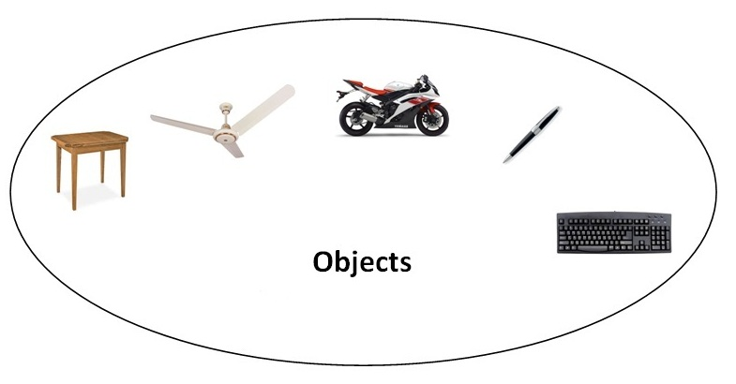
Java OOPs Concepts
Object means a real word entity such as pen, chair, table etc. Object-Oriented Programming is a methodology or paradigm to design a program using classes and objects.
Object
Class
Inheritance
Polymorphism
Abstraction
Encapsulation

Slide 31
Object in Java
Object: An entity that has state and behavior is known as an object e.g. chair, bike, marker, pen, table, car etc. It can be physical or logical.
State: represents data (value) of an object.
behavior: represents the behavior (functionality) of an object such as deposit, withdraw etc.
identity: Object identity is typically implemented via a unique ID. The value of the ID is not visible to the external user. But, it is used internally by the JVM to identify each object uniquely.
Object is an instance of a class. Class is a template or blueprint from which objects are created. So object is the instance(result) of a class.

Slide 32
Class in Java
A class is a group of objects which have common properties. It is a template or blueprint from which objects are created. It is a logical entity. It can't be physical.
A class in Java can contain:
fields
methods
constructors
blocks
nested class and interface
Instance variable - A variable which is created inside the class but outside the method, is known as instance variable. Instance variable doesn't get memory at compile time. It gets memory at run time when object(instance) is created.
Method in Java: In java, a method is like function i.e. used to expose behavior of an object.
Advantages:
Code Reusability
Code Optimization

Slide 33
Class in Java cont..
new keyword in Java
- The new keyword is used to allocate memory at run time. All objects get memory in Heap memory area.
Example:
class Student{
int id;//field or data member or instance variable
String name;
public static void main(String args[]){
Student s1=new Student();//creating an object of Student
System.out.println(s1.id);//accessing member through reference variable
System.out.println(s1.name);
} }

Slide 34
Class in Java cont.
Constructor:
- In Java, constructor is a block of codes similar to method. It is called when an instance of object is created and memory is allocated for the object.
Rules:
- Constructor name must be same as its class name
- Constructor must have no explicit return type
Example:
// default constructor
class Bike1{
Bike1(){System.out.println("Bike is created");}
public static void main(String args[]){
Bike1 b=new Bike1();
} }
Output: Bike is created

Slide 35
Class in Java cont.
Parameterized Constructor:
class Student4
{
int id; String name; Student4(int, String n)
{
id = i; name = n;
}
void display()
{
System.out.println(id+" "+name);
}
public static void main(String args[]){
Student4 s1 = new Student4(111,"Karan");
Student4 s2 = new Student4(222,"Aryan");
s1.display();
s2.display();
}
} Output:
111 , Karan
222, Aryan

Slide 36
Java OOPs cont.
Inheritance:
Inheritance is an object oriented concept which allows code re-use by creating parent and child relationship. extends is the keyword used to inherit the properties of a class. // Sample code
class Calculation {
int z;
public void addition(int x, int y) {
z = x + y;
System.out.println("The sum of the given numbers:"+z);
}
public void Subtraction(int x, int y) {
z = x - y;
System.out.println("The difference between the given numbers:"+z);
}
}

Slide 37
Java OOPs cont. Inheritance
public class My_Calculation extends Calculation {
public void multiplication(int x, int y) {
z = x * y;
System.out.println("The product of the given numbers:"+z);
}
public static void main(String args[]) {
int a = 20, b = 10;
My_Calculation demo = new My_Calculation();
demo.addition(a, b);
demo.Subtraction(a, b);
demo.multiplication(a, b);
}
}

Slide 38
Java OOPs cont.
Polymorphism:
When one task is performed by different ways i.e. known as polymorphism. The word ‘polymorphism’ literally means ‘a state of having many shapes’ or ‘the capacity to take on different forms’.
Polymorphism
Compile Polymorphism
Runtime Polymorphism

Slide 39
Java OOPs cont.
// Example Program about compile time polymorphism
class DemoOverload{
public int add(int x, int y){ //method 1
return x+y;
}
public int add(int x, int y, int z){ //method 2
return x+y+z;
}
class Test{
public static void main(String[] args){
DemoOverload demo=new DemoOverload();
System.out.println(demo.add(2,3)); //method 1 called
System.out.println(demo.add(2,3,4)); //method 2 called } }

Slide 40
Java OOPs cont.
// Example Program for runtime polymorphism – Method overriding
class Vehicle{
public void move(){
System.out.println(“Vehicles can move!!”);
}}
class MotorBike extends Vehicle{
public void move(){
System.out.println(“MotorBike can move and accelerate too!!”);
}}
class Test{
public static void main(String[] args){
Vehicle vh=new MotorBike();
vh.move(); // prints MotorBike can move and accelerate too!!
vh=new Vehicle();
vh.move(); // prints Vehicles can move!!
}}

Slide 41
Java OOPs cont.
Abstract Class
A class that is declared with abstract keyword, is known as abstract class in java. It can have abstract and non-abstract methods (method with body).
Abstraction is a process of hiding the implementation details and showing only functionality to the user.
Another way, it shows only important things to the user and hides the internal details for example sending sms, you just type the text and send the message. You don't know the internal processing about the message delivery.
abstract class A{} // Example Abstract class
abstract void printStatus();//no body and abstract

Slide 42
Java OOPs cont.
// Example class
abstract class Bank{
abstract int getRateOfInterest();
}
class SBI extends Bank{
int getRateOfInterest(){return 7;}
}
class PNB extends Bank{
int getRateOfInterest(){return 8;}
}
class TestBank{
public static void main(String args[]){
Bank b;
b=new SBI();
System.out.println("Rate of Interest is: "+b.getRateOfInterest()+" %");
b=new PNB();
System.out.println("Rate of Interest is: "+b.getRateOfInterest()+" %");
}}
Output:
Rate of Interest is: 7 %
Rate of Interest is: 8 %

Slide 43
Java OOPs cont.
Rules:
If there is any abstract method in a class, that class must be abstract.
class Bike12{
abstract void run();
}
Output: compile time error
If you are extending any abstract class that have abstract method, you must either provide the implementation of the method or make this class abstract.

Slide 44
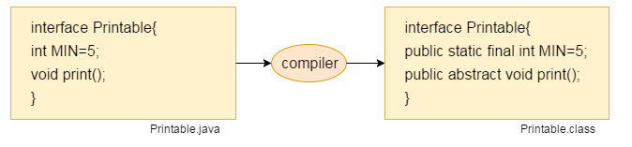
Interface in Java
- An interface in java is a blueprint of a class. It has static constants and abstract methods.
Why use Java interface?
There are mainly three reasons to use interface. They are given below.
It is used to achieve abstraction.
By interface, we can support the functionality of multiple inheritance.
Since Java 8, interface can have default and static methods

Slide 45
Interface in Java
There can be only abstract methods in the java interface not method body. It is used to achieve abstraction and multiple inheritance in Java.
// Example
interface printable{
void print();
}
class A6 implements printable{
public void print(){System.out.println("Hello");}
public static void main(String args[]){
A6 obj = new A6();
obj.print();
}
}
Output: Hello

Slide 46
Interface in Java
// another example
interface Printable{
void print();
}
interface Showable{
void show();
}
class A7 implements Printable,Showable{
public void print(){System.out.println("Hello");}
public void show(){System.out.println("Welcome");}
public static void main(String args[]){
A7 obj = new A7();
obj.print();
obj.show();
}
}

Slide 47
Java 8 Static method interface
// another example
interface Drawable{
void draw();
static int cube(int x){return x*x*x;}
}
class Rectangle implements Drawable{
public void draw(){System.out.println("drawing rectangle");}
}
class TestInterfaceStatic{
public static void main(String args[]){
Drawable d=new Rectangle();
d.draw();
System.out.println(Drawable.cube(3));
}}
Output:
drawing rectangle 27

Slide 48
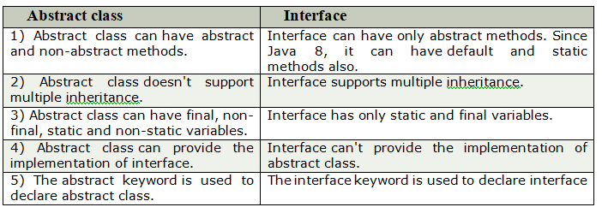
Abstract class and Interface difference

Slide 49
Encapsulation
- Encapsulation in java is a process of wrapping code and data together into a single unit, for example capsule i.e. mixed of several medicines.
Make the instance variables private so that they cannot be accessed directly from outside the class. You can only set and get values of these variables through the methods of the class.
By providing only setter or getter method, you can make the class read-only or write-only.
Examples:
public class Student{
private String name;
public String getName(){
return name;
}
public void setName(String name){
this.name=name
} }

Slide 50
Encapsulation
//save as Test.java
package com.javatest;
class Test{
public static void main(String[] args){
Student s=new Student();
s.setName(“John");
System.out.println(s.getName());
}
}
Output: John

Slide 51
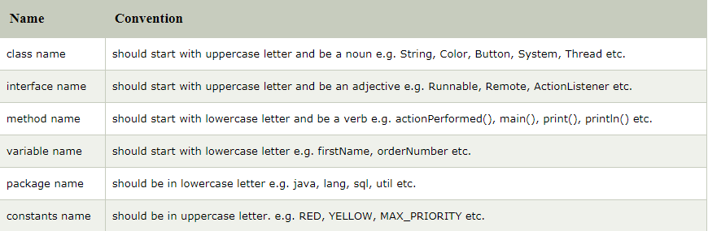
Naming Conventions

Slide 52
Static Keyword
Class Methods – Static Methods
Class Methods, similar to Class variables can be invoked without having an instance of the Class. Class methods are often used to provide global functions for Java programs.
Example
class Languages {
public static void main(String[] args) {
display();
}
static void display() {
System.out.println("Java is my favorite programming language."); }
}

Slide 53
Static Keyword
The static keyword in java is used for memory management mainly. We can apply java static keyword with variables, methods and blocks.
Class variable – Static fields
Class variables also known as static fields share characteristics across all Objects within a Class.
Example: static String college ="ITS";

Slide 54
Static Keyword
Static block:
- Static block gets executed exactly once, when the class is first loaded in the memory.
Example
class JavaExample{
static int num;
static String mystr;
static{
num = 97;
mystr = "Static keyword in Java";
}
public static void main(String args[])
{
System.out.println("Value of num: "+num);
System.out.println("Value of mystr: "+mystr);
}
}

Slide 55
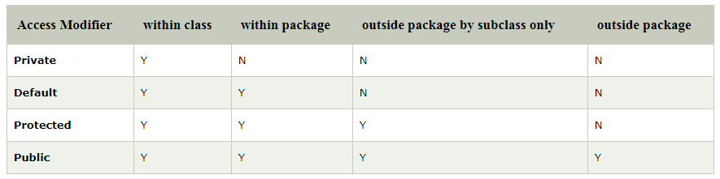
Access Modifier
There are two types of modifiers in java: access modifiers and non-access modifiers.
The access modifiers in java specifies accessibility (scope) of a data member, method, constructor or class.
There are 4 types of java access modifiers:
private
default
Protected (not for class)
Public
Non-access modifiers such as static, abstract, synchronized, native, volatile, transient etc. Here, we will learn access modifiers.

Slide 56
Access Modifier
1. Private access modifier:
class A{
private int data=40;
private void msg(){System.out.println("Hello java");}
}
public class Simple{
public static void main(String args[]){
A obj=new A();
System.out.println(obj.data);//Compile Time Error
obj.msg();//Compile Time Error
}
}
Rule: If you make any class constructor private, you cannot create the instance of that class from outside the class

Slide 57
Access Modifier
2. Default access modifier:
If you don't use any modifier, it is treated as default by default. The default modifier is accessible only within package.
Example scenario:
In this example, we have created two packages pack and mypack. We are accessing the A class from outside its package,
since A class is not public, so it cannot be accessed from outside the package.
package pack;
class A{
void msg(){System.out.println("Hello");}
}
package mypack;
import pack.*;
class B{
public static void main(String args[]){
A obj = new A();//Compile Time Error
obj.msg();//Compile Time Error
}}

Slide 58
Access Modifier
3. Protected access modifier:
The protected access modifier is accessible within package and outside the package but through inheritance only.
In this example, msg method of this package is declared as protected, so it can be accessed from outside the class only through inheritance.
Example:
package pack;
public class A{
protected void msg(){System.out.println("Hello");}
}
package mypack;
import pack.*;
class B extends A{
public static void main(String args[]){
B obj = new B();
obj.msg();
} }
o/p: Hello

Slide 59
Access Modifier
3. Public modifier
The public access modifier is accessible everywhere. It has the widest scope among all other modifiers.
Example:
package pack;
public class A{
public void msg(){System.out.println("Hello");}
}
package mypack;
import pack.*;
class B{
public static void main(String args[]){
A obj = new A();
obj.msg();
} }
Output: Hello

Slide 60
- this Keyword in Java
Usages:
this can be used to refer current class instance variable.
this can be used to invoke current class method (implicitly)
this() can be used to invoke current class constructor.
this can be passed as an argument in the method call.
this can be passed as argument in the constructor call.
this can be used to return the current class instance from the method.
class Student{
int rollno;
Student(int rollno){
this.rollno=rollno;
}
void display(){System.out.println(rollno);}
}
class TestThis2{
public static void main(String args[]){
Student s1=new Student(111);
Student s2=new Student(112);
s1.display();
s2.display(); }}

Slide 61
- super Keyword in Java
- The super keyword in java is a reference variable which is used to refer immediate parent class object.
Usage of java super Keyword
super can be used to refer immediate parent class instance variable.
super can be used to invoke immediate parent class method.
super() can be used to invoke immediate parent class constructor.
Example:
class Animal{
String color="white";
}
class Dog extends Animal{
String color="black";
void printColor(){
System.out.println(color);//prints color of Dog class
System.out.println(super.color);//prints color of Animal class
}
}
}}

Slide 62
- super Keyword in Java
class TestSuper1{
public static void main(String args[]){
Dog d=new Dog();
d.printColor();
}}
Output:
black
white

Slide 63
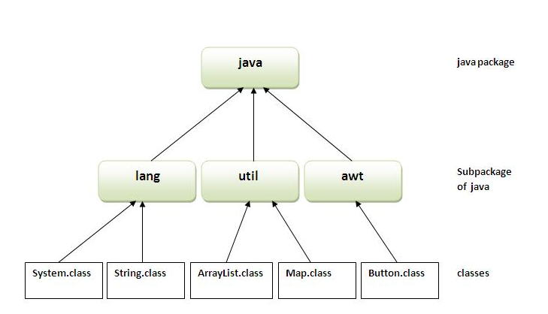
Packages
- A java package is a group of similar types of classes, interfaces and sub-packages.
- Package in java can be categorized in two form, built-in package and user-defined package.
There are many built-in packages such as java, lang, awt, javax, swing, net, io, util, sql etc.

Slide 64
OOPs Assignment
Create StudentAddress, StudentMark classes and get the method from parent class by using Inheritance.
Create Interface with interateRate and implement the interestRate method in class.
Create a method login function with below Signature.
userName
userName, passWord
userName,passWord, domain
Write a wrapper method (getter and Setter) to print the student name and Marks.
Write a program to use this and super keyword.
Write a abstract method and same method implementation in non-abstract method.

Slide 65
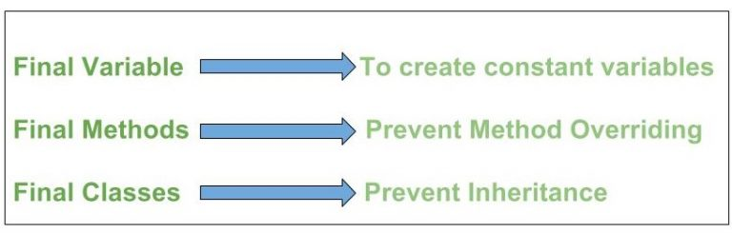
final Keyword
The final keyword in java is used to restrict the user. The java final keyword can be used in many context.
Variable - Cannot change the value of final variable(It will be constant).
Ex: final int interestRate=12; //final variable
Method - Make any method as final, you cannot override it.
class Bike{
final void run(){System.out.println("running");}
}
class Honda extends Bike{
void run(){System.out.println("running safely with 100kmph");}
public static void main(String args[]){
Honda honda= new Honda();
honda.run();
} }
Output: Compile Time Error

Slide 66
Java final Class
If you make any class as final, you cannot extend it.
Example:
final class Bike{}
class Honda1 extends Bike{
void run(){System.out.println("running safely with 100kmph");}
public static void main(String args[]){
Honda1 honda= new Honda1();
honda.run();
}
}
Output: Compilation Error

Slide 67
Java Enum
Enum in java is a data type that contains fixed set of constants.
//Example 1
class EnumExample1{
public enum Season { WINTER, SPRING, SUMMER, FALL }
public static void main(String[] args) {
for (Season s : Season.values())
System.out.println(s);
}}
Output:WINTER SPRING SUMMER FALL
//Example 2
enum Season { WINTER, SPRING, SUMMER, FALL }
class EnumExample2{
public static void main(String[] args) {
Season s=Season.WINTER;
System.out.println(s);
}}
Output: WINTER

Slide 68
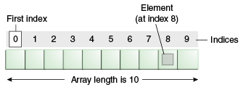
Array in Java
Normally, array is a collection of similar type of elements that have contiguous memory location.
Java array is an object the contains elements of similar data type. It is a data structure where we store similar elements. We can store only fixed set of elements in a java array.
Advantage of Java Array
Code Optimization: It makes the code optimized, we can retrieve or sort the data easily.
Random access: We can get any data located at any index position.

Slide 69
Array in Java
class GFG
{
public static void main (String[] args)
{
// declares an Array of integers.
int[] arr;
// allocating memory for 5 integers.
arr = new int[5];
// initialize the first elements of the array
arr[0] = 10;
// initialize the second elements of the array
arr[1] = 20;
// accessing the elements of the specified array
for (int i = 0; i < arr.length; i++)
System.out.println("Element at index " + i +
" : "+ arr[i]);
}
}

Slide 70
Array in Java
Disadvantage of Java Array
Size Limit: We can store only fixed size of elements in the array. It doesn't grow its size at runtime. To solve this problem, collection framework is used in java.
Example:
int a[]=new int[4]; //declaration and instantiation
a[0]=10;//initialization
a[1]=20;
a[2]=70;
a[3]=40;

Slide 71
String in Java
In java, string is basically an object that represents sequence of char values. An array of characters works same as java string. For example:
char[] ch={'j','a','v','a'};
String s=new String(ch);
Is same as
String s="java";
Every immutable object in Java is thread safe ,that implies String is also thread safe . String can not be used by two threads simultaneously. String once assigned can not be changed.
Java String class provides a lot of methods to perform operations on string such as compare(), concat(), equals(), split(), length(), replace(), compareTo(), intern(), substring() etc.

Slide 72
String in Java
// find a length of the String
public class StringDemo { public static void main(String args[])
{
String palindrome = "Dot saw I was Tod";
int len = palindrome.length();
System.out.println( "String Length is : " + len );
}
}
Output: String Length is : 17
// Concatenating
string1.concat(string2);
Hello.concat(“World!”);
or
+ operator
System.out.println(“"Hello," + " world" + "!“);

Slide 73
String in Java
// CharAt
public class CharAtExample {
public static void main(String args[])
{
String str = "Welcome to string handling tutorial";
char ch1 = str.charAt(0);
System.out.println("Character at 0 index is: "+ch1);
}
}
//Contains
String str = "Game of Thrones"; //This will print "true" because "Game" is present in the given String
System.out.println(str.contains("Game"));
//Substring
String substring(int beginIndex)
String substring(int beginIndex, int endIndex):
// value of
public static String valueOf(boolean b): Used for converting boolean value to a String public static String valueOf(char c): char to String public static String valueOf(int i): int to String public static String valueOf(long l): long to String

Slide 74
String in Java
public class Example
{
public static void main(String args[])
{ int i = 10; //int value
float f = 10.10f; //float
}
}
o/p:
10
10.1
// Starting with
boolean startsWith(String str)
boolean startsWith(String str, index fromIndex)
//split
public class SplitExample{
public static void main(String args[]){
String str = new String("28/12/2013");
String array1[]= str.split("/");
for (String temp: array1){
System.out.println(temp);
}
}

Slide 75
String in Java
// endsWith
public class EndsWithExample
{
public static void main(String args[])
{
String str1 = new String("This is a test String");
boolean var1 = str1.endsWith("String");
}
}
Output: true
// indexOf
String str1 = new String("This is a Beginners Book tutorial");
System.out.println("Index of B in str1: "+str1.indexOf('B')); System.out.println("Index of B in str1 after 15th char:"+str1.indexOf('B', 15)); System.out.println("Index of B in str1 after 30th char:"+str1.indexOf('B', 30));
//Compare to Ignore case - It returns 0 when the strings are equal else it returns positive or negative value.
String string1 = "HELLO"; String string2 = "hello";
int var1 = string1.compareToIgnoreCase(string2);

Slide 76
String in Java
//isEmpty() method checks whether a String is empty or not.
public class Example{
public static void main(String args[]){
//empty string
String str1="";
//non-empty string
String str2="hello";
//prints true
System.out.println(str1.isEmpty());
//prints false
System.out.println(str2.isEmpty());
}
}
Output:
true
false

Slide 77
StringBuffer and StringBuilder in Java
StringBuffer is mutable means one can change the value of the object . The object created through StringBuffer is stored in the heap. StringBuffer has the same methods as the StringBuilder , but each method in StringBuffer is synchronized that is StringBuffer is thread safe .
Due to this it does not allow two threads to simultaneously access the same method . Each method can be accessed by one thread at a time .
StringBuffer demo1 = new StringBuffer("Hello") ;
demo1=new StringBuffer("Bye");
StringBuilder is same as the StringBuffer , that is it stores the object in heap and it can also be modified . The main difference between the StringBuffer and StringBuilder is that StringBuilder is not thread safe.
StringBuilder demo1 = new StringBuilder("Hello") ;
demo1=new StringBuilder("Bye");

Slide 78
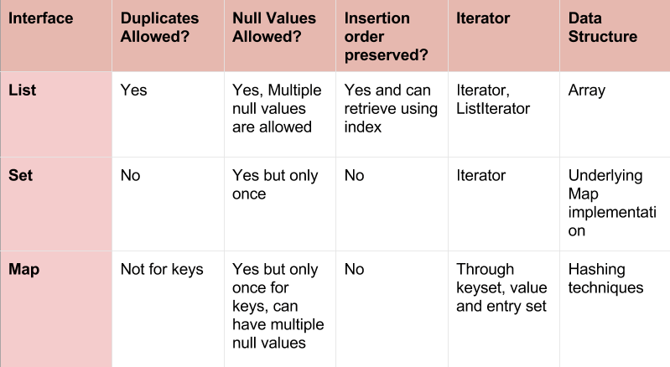
Collections in Java

Slide 79
Collections in Java
Collection is the root of the collection hierarchy. A collection represents a group of objects known as its elements.
List is an ordered collection and can contain duplicate elements. You can access any element from it’s index. List is more like array with dynamic length.
List is an ordered collection of objects in which duplicate values can be stored.
Since List preserves the insertion order it allows positional access and insertion of elements.
List Interface is implemented by ArrayList, LinkedList, Vector and Stack classes.
Iterator:
It is used to traverse a collection object elements one by one.
It is applicable for all Collection classes.
It supports both READ and REMOVE Operations.

Slide 80
Java Collection - Arraylist
//Example
import java.util.*;
public class NewTest
{
public static void main(String args[])
{
List<String> list=new ArrayList<String>();//Creating arraylist
list.add(“apple");//Adding object in arraylist
list.add(“orange");
list.add(“apple");
//Traversing list through Iterator
Iterator itr=list.iterator();
while(itr.hasNext()){
System.out.println(itr.next());
}
}

Slide 81
Java Collection - LinkedList
Java LinkedList class uses doubly linked list to store the elements.
It provides a linked-list data structure.
The important points about Java LinkedList are:
Java LinkedList class can contain duplicate elements.
Java LinkedList class maintains insertion order.
Java LinkedList class is non synchronized.
import java.util.*;
LinkedList<String> al=new LinkedList<String>();
al.add(“apple");//Adding object in arraylist
al.add(“orange");
al.add(“apple");
//Traversing list through Iterator
Iterator itr=al.iterator();
while(itr.hasNext()){
System.out.println(itr.next());
}
}

Slide 82
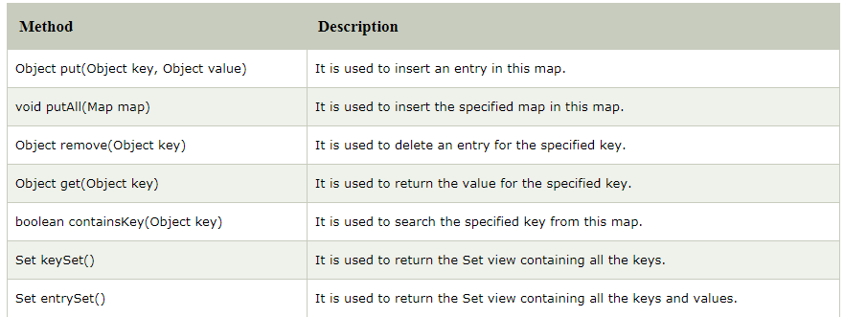
Map Interface
A map contains values on the basis of key i.e. key and value pair.
Each key and value pair is known as an entry. Map contains only unique keys.
Map is useful if you have to search, update or delete elements on the basis of key

Slide 83
Java HashMap Class
The important points about Java HashMap class are:
A HashMap contains values based on the key.
It contains only unique elements.
It may have one null key and multiple null values.
It maintains no order.
Example:
import java.util.*;
class TestCollection13{
public static void main(String args[]){
HashMap<Integer,String> hm=new HashMap<Integer,String>();
hm.put(1,"Amit"); // we can remove by using hm.remove(1);
hm.put(2,"Vijay");
hm.put(3,"Rahul");
for(Map.Entry m:hm.entrySet()){
System.out.println(m.getKey()+" "+m.getValue());
} }}
Output: 3 Rahul 1 Amit 2 Vijay

Slide 84
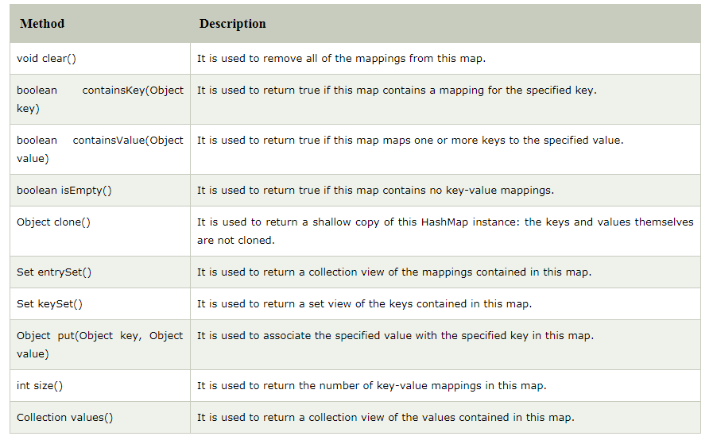
Java HashMap Available Methods

Slide 85
LinkedHashMap
Java LinkedHashMap class is Hash table and Linked list implementation of the Map interface, with predictable iteration order.
The important points about Java LinkedHashMap class are:
A LinkedHashMap contains values based on the key.
It contains only unique elements.
It may have one null key and multiple null values.
It is same as HashMap instead maintains insertion order.
Example:
// Initiate the map and adding the value
hm.put(1,"Amit"); // we can remove by using hm.remove(1);
hm.put(2,"Vijay");
hm.put(3,"Rahul");
for(Map.Entry m:hm.entrySet()){
System.out.println(m.getKey()+" "+m.getValue());
} }}
Output: 1 Amit 2 Vijay 3 Rahul

Slide 86
Hash Set class
Hash Set doesn’t allow duplicate entries.
Hash Set allows null as a value.
Hash Set doesn’t guarantee the insertion order of elements.
Example:
import java.util.*;
class TestCollection9{
public static void main(String args[]){
//Creating HashSet and adding elements
HashSet<String> set=new HashSet<String>();
set.add("Ravi");
set.add("Vijay");
set.add("Ravi");
set.add("Ajay");
//Traversing elements
Iterator<String> itr=set.iterator();
while(itr.hasNext()){
System.out.println(itr.next());
} } }
Output:
Ajay
Vijay
Ravi

Slide 87
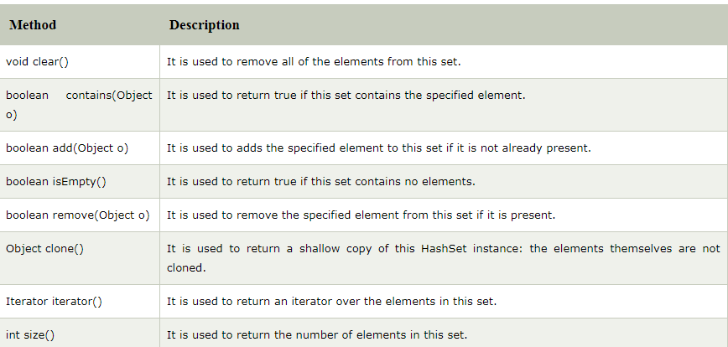
Hash Set class available Methods

Slide 88
Hash Set class available Methods

Slide 89
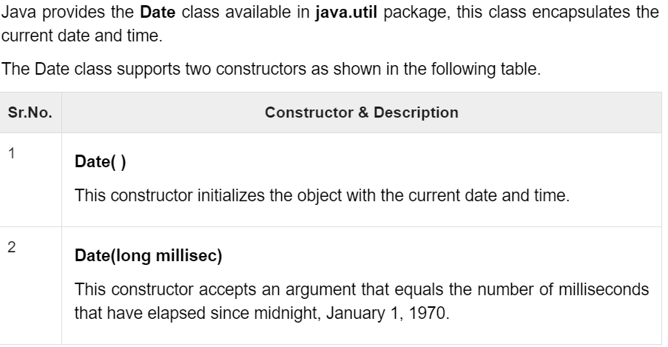
Date and Time

Slide 90
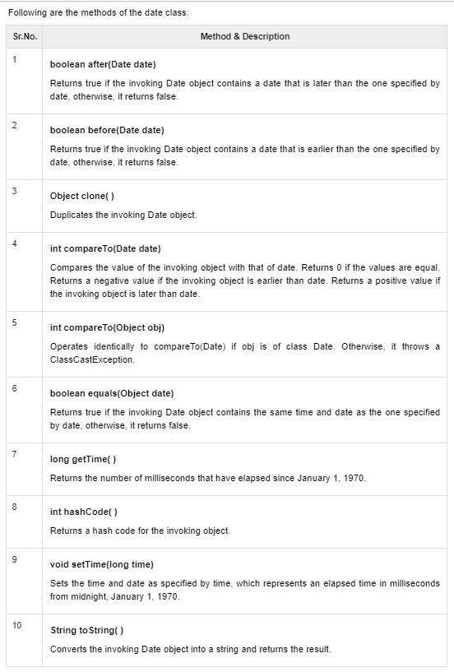
Date and Time

Slide 91
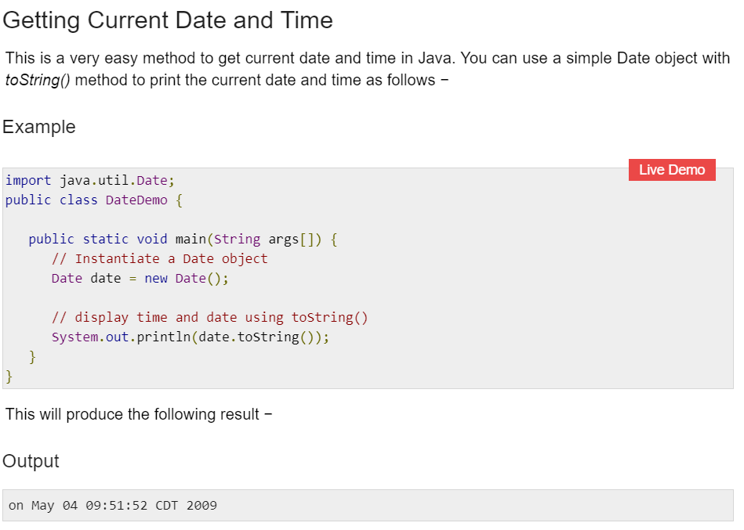
Date and Time

Slide 92
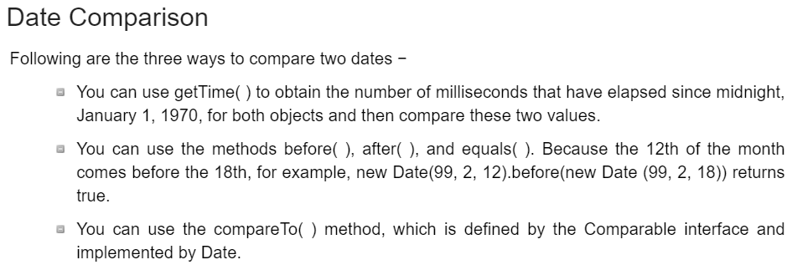
Date and Time

Slide 93
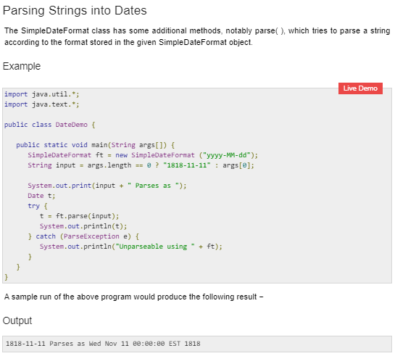
Date and Time

Slide 94
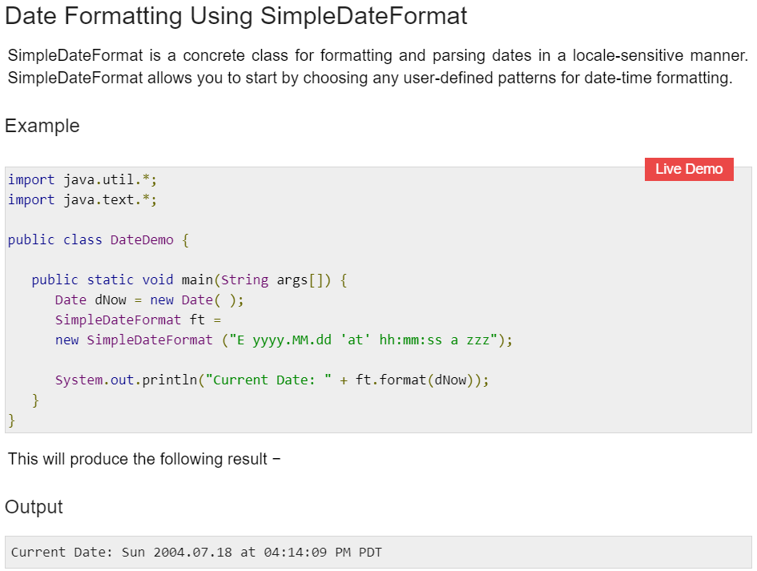
Date and Time

Slide 95
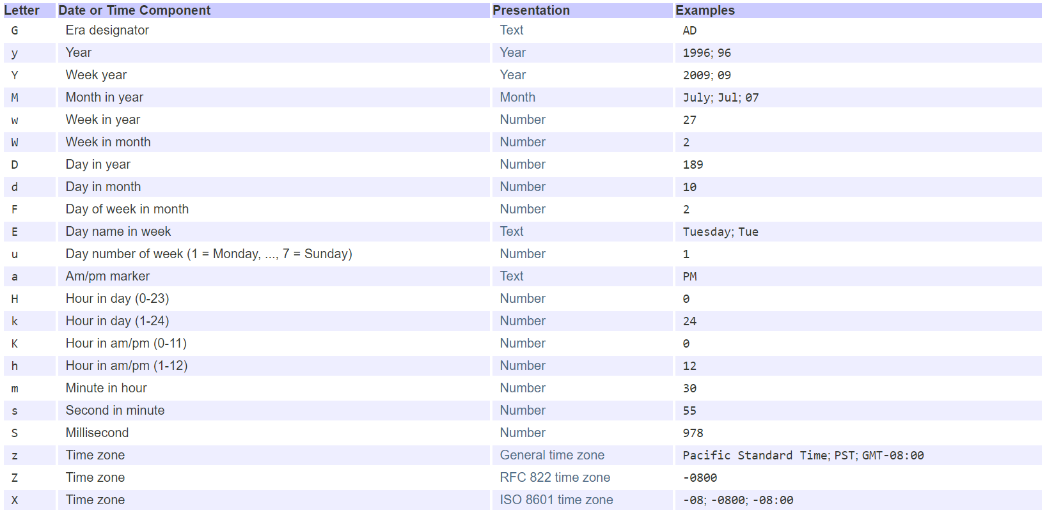
Date and Time

Slide 96
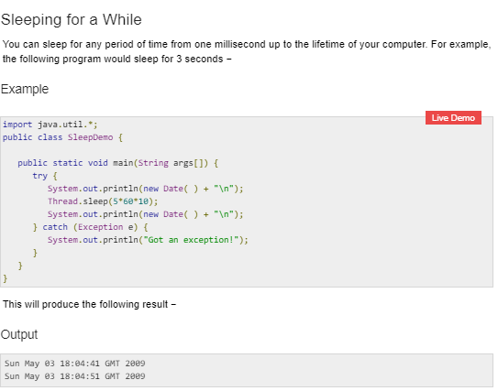
Date and Time

Slide 97
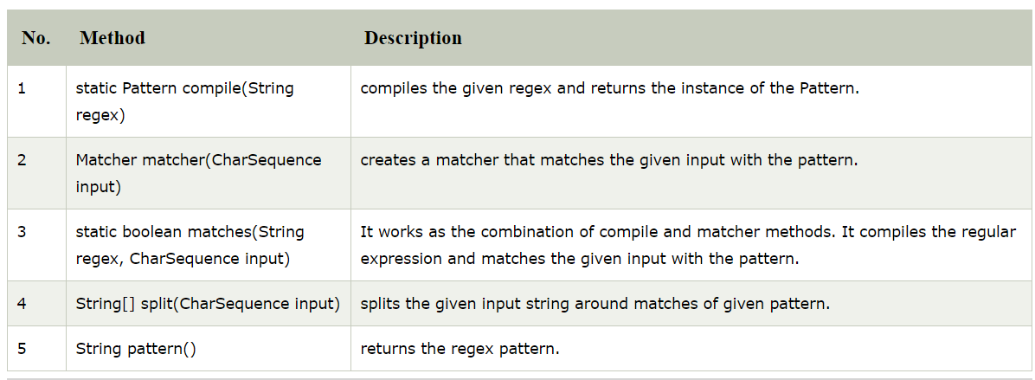
RegEx- Pattern

Slide 98
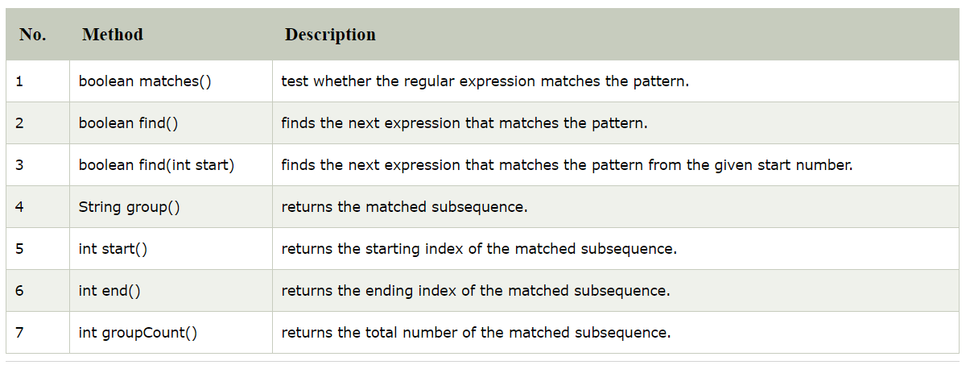
RegEx - Matcher

Slide 99
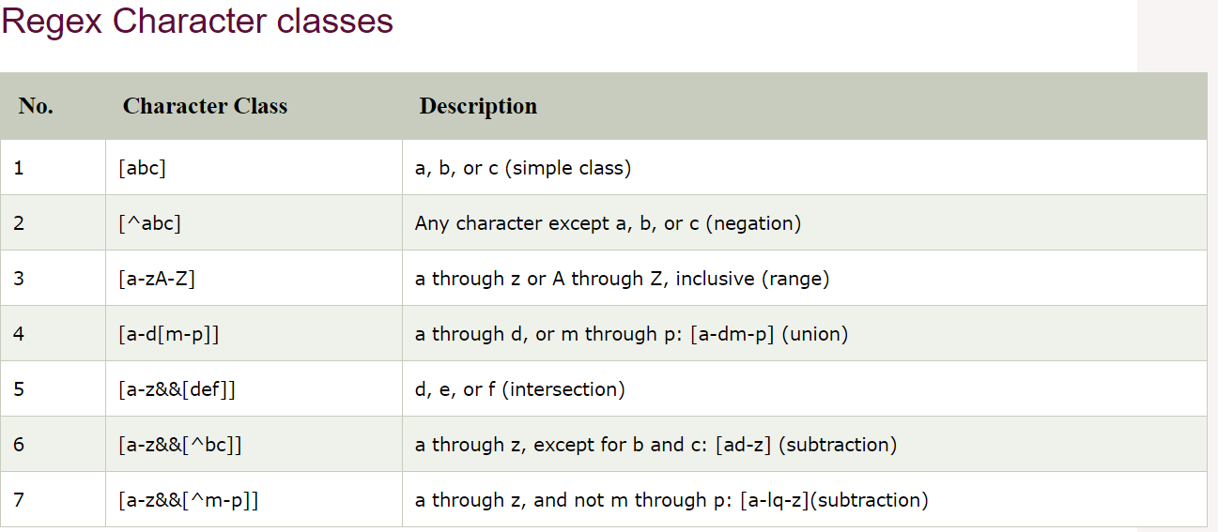
RegEx

Slide 100
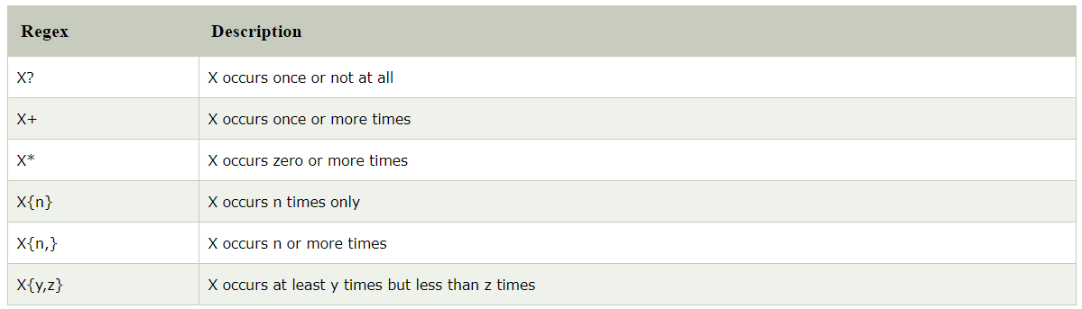
RegEx Quantifier

Slide 101
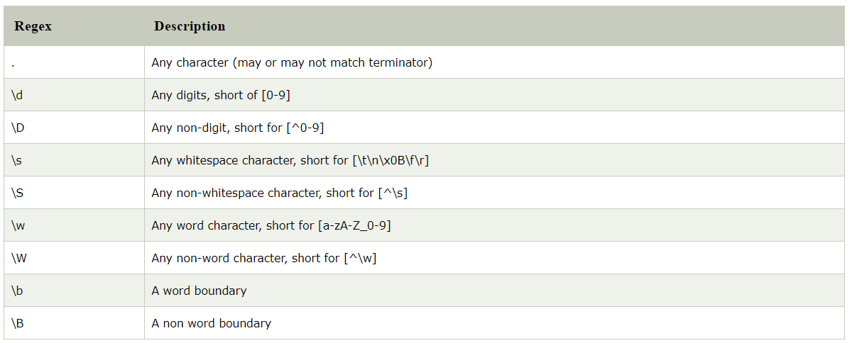
RegEx MetaCharacter

Slide 102
Exceptions in Java
An exception is an event, which occurs during the execution of a program.
The core advantage of exception handling is to maintain the normal flow of the application. Exception normally disrupts the normal flow of the application that is why we use exception handling.
There are mainly two types of exceptions: checked and unchecked where error is considered as unchecked exception.
Checked Exception
Checked Exception in Java is all those Exception which requires being catches and handled during compile time. If Compiler doesn’t see try or catch block handling a Checked Exception, it throws Compilation error.

Slide 103
Exceptions in Java
//Example
import java.io.*;
class Main {
public static void main(String[] args) throws IOException {
FileReader file = new FileReader("C:\\test\\a.txt");
BufferedReader fileInput = new BufferedReader(file);
for (int counter = 0; counter < 3; counter++)
System.out.println(fileInput.readLine());
fileInput.close(); }}
2) Unchecked Exception
Unchecked exceptions are not checked at compile-time rather they are checked at runtime.
The classes that extend RuntimeException are known as unchecked exceptions e.g. ArithmeticException, NullPointerException, ArrayIndexOutOfBoundsException etc.

Slide 104
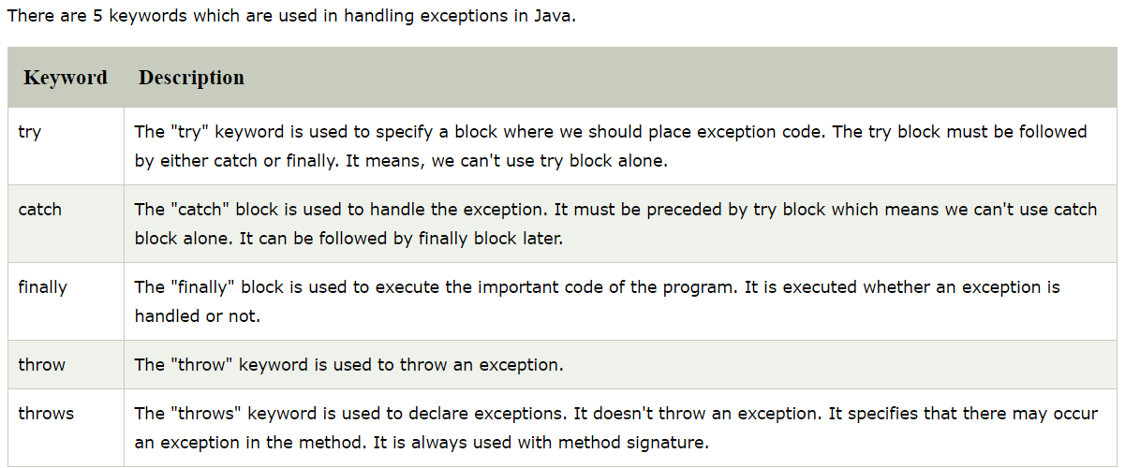
Java Exception Keywords

Slide 105
Exceptions in Java
Example:
class Main {
public static void main(String args[]) {
int x = 0;int y = 10;
int z = y/x;
}}
Output: Exception in thread "main" java.lang.ArithmeticException: / by zero.
// Handling Exception
try {
int x = 0;int y = 10;
int z = y/x;
System.out.println ("Result = " + z);
}
catch(ArithmeticException e) {
System.out.println ("Can't divide a number by 0");
}

Slide 106
class StringIndexOutOfBound_Demo
{
public static void main(String args[])
{
try {
String a = "This is like chipping "; // length is 22
char c = a.charAt(24); // accessing 25th element
System.out.println(c);
}
catch(StringIndexOutOfBoundsException e) {
System.out.println("StringIndexOutOfBoundsException");
}
}
}
Output: StringIndexOutOfBoundsException
Exceptions in Java
// Another Example

Slide 107
class ArrayIndexOutOfBound_Demo
{
public static void main(String args[])
{
try{
int a[] = new int[5];
a[6] = 9; // accessing 7th element in an array of
// size 5
}
catch(ArrayIndexOutOfBoundsException e){
System.out.println ("Array Index is Out Of Bounds");
}
}
}
Output: Array Index is Out Of Bounds
Exceptions in Java
// Another Example

Slide 108
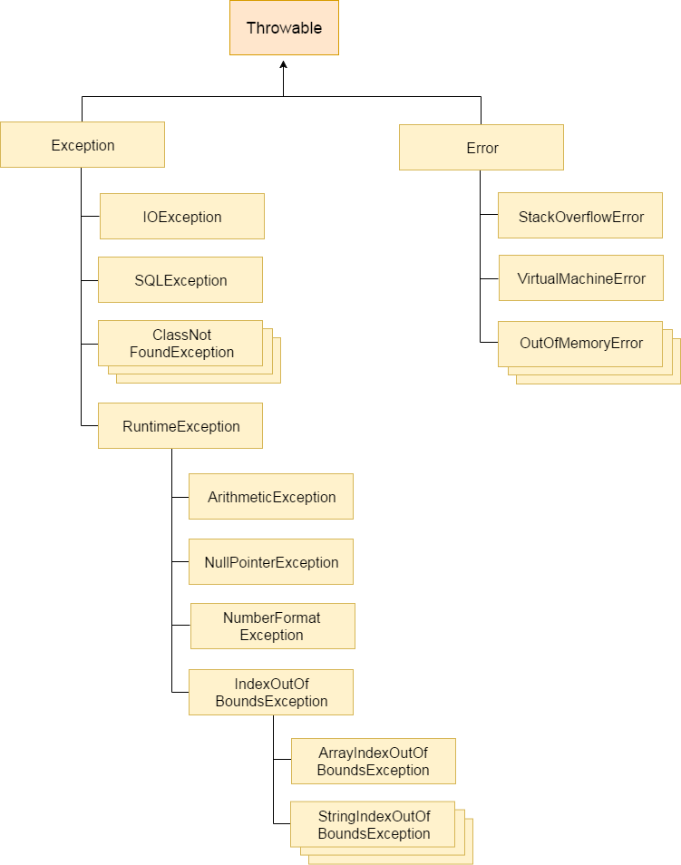

Slide 109
Java Try-Catch block
Java try block
Java try block is used to enclose the code that might throw an exception. It must be used within the method.
Java try block must be followed by either catch or finally block.
Java Catch block
Java catch block is used to handle the Exception. It must be used after the try block only.
You can use multiple catch block with a single try.
// Example
public class Test{
public static void main(String args[]){
Try {
int data=100/0;// Exception Handling
}catch(ArithmeticException e){System.out.println(e);}
System.out.println("rest of the code..."); }}

Slide 110
finally block
Java finally block is a block that is used to execute important code such as closing connection, stream etc.
Java finally block is always executed whether exception is handled or not.
Java finally block follows try or catch block.
// Example
class TestFinallyBlock{
public static void main(String args[]){
try{
int data=25/5;
System.out.println(data);
}
catch(NullPointerException e){System.out.println(e);}
finally{System.out.println("finally block is always executed");}
System.out.println("rest of the code...");
}
}
Output:
5
finally block is always executed
rest of the code...

Slide 111
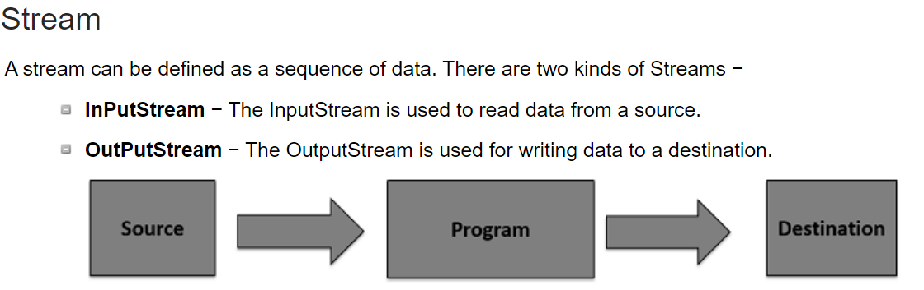
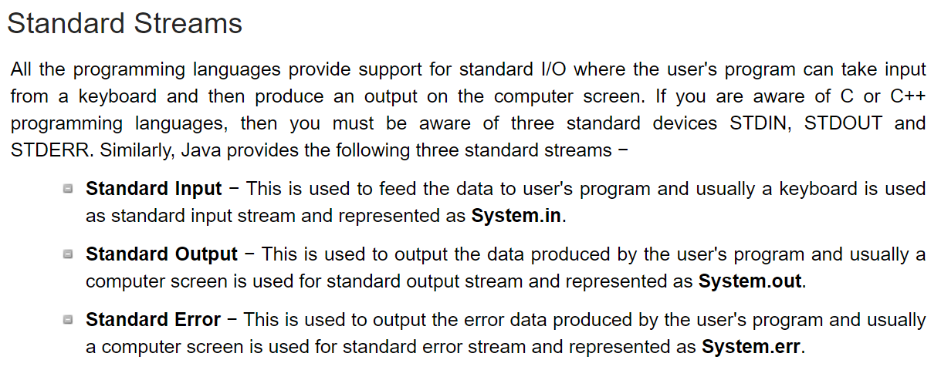
Streams

Slide 112
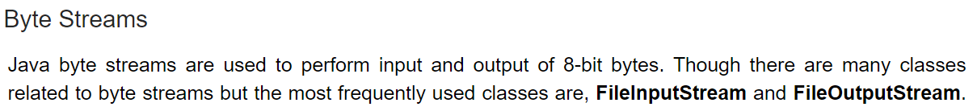
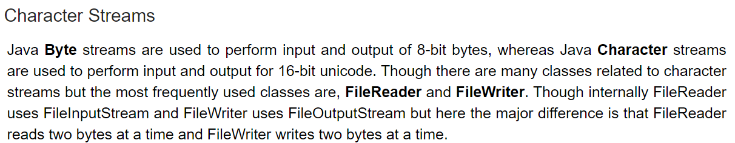
Streams

Slide 113
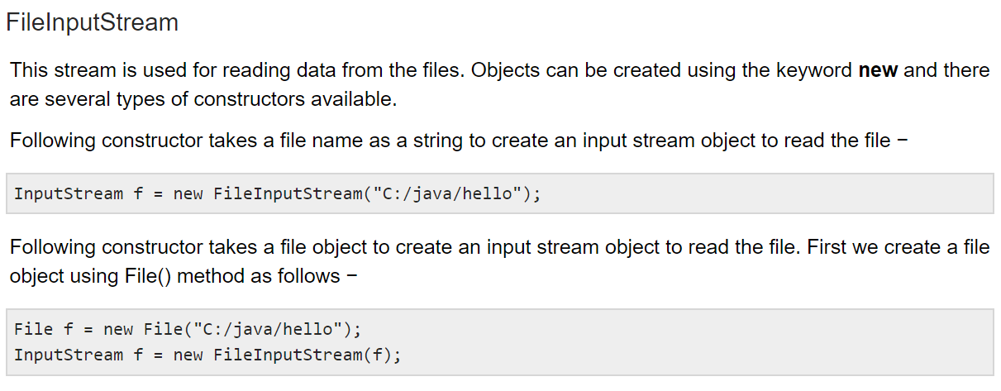
Streams

Slide 114
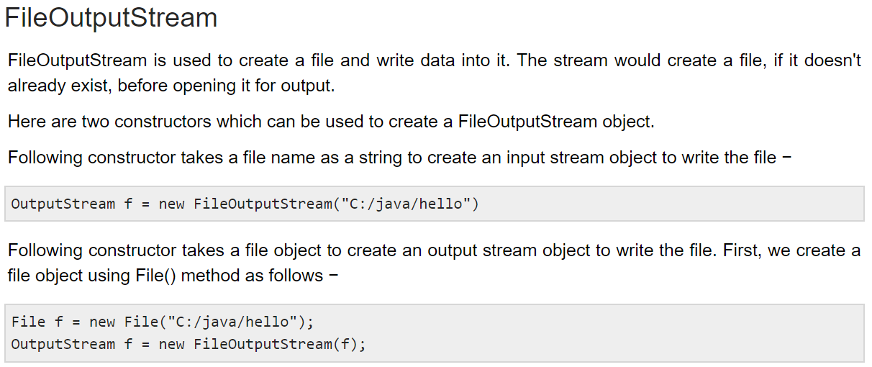
Streams

Slide 115
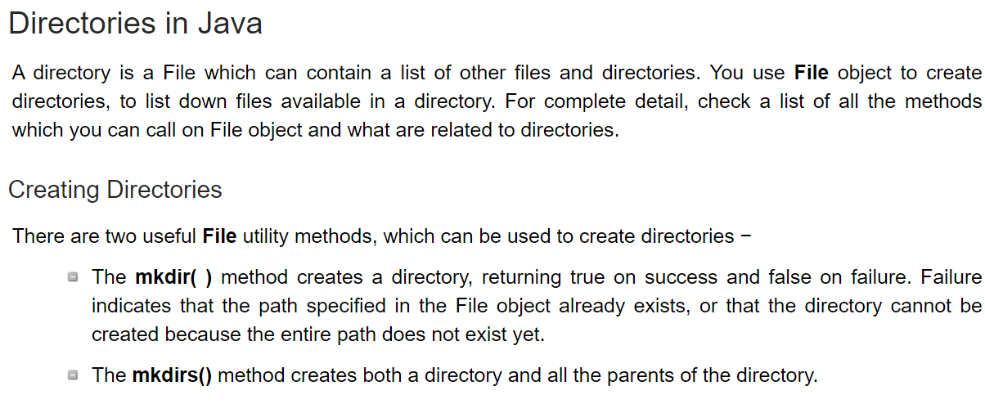
File Navigation and I/O

Slide 116
Thank you!

